Slide 1
Microprocessor and Assembly language
shamiM AHMAD

Slide 2

Computer Science
Computer Science and Engineering
Computer Engineering

Slide 3
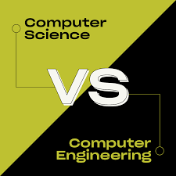

Slide 4

1945:
Columbia University offering one of the first academic-credit courses in computer science
1953:
The world's first computer science degree program, the Cambridge Diploma in Computer Science, University of Cambridge
1959:
The term "computer science" appears in an article in Communications of the ACM

Slide 5
The first computer engineering degree program
1971 at Case Western Reserve University in Cleveland, Ohio, USA

Slide 6


What is computer science?
Computer science is the study of technology and how it can help solve problems.
Programming
Game design
Web design
Robotics
Data analysis
Algorithmics
Artificial intelligence
Network architecture,
How computers are used in society

Slide 7
What is computer engineering?
As a computer engineer, you’ll design and build hardware for computer systems and often work with software.
Designing computer hardware
Testing and analyzing computer systems
Ensuring hardware and software work together

Slide 8
Examples of computer science jobs
Database administrator
Data scientist
Systems analyst
Software developer
Software quality assurance manager
Web developer
Computer programmer
Computer support specialist
AI research scientist

Slide 9
Examples of computer engineering jobs
Computer architect
Circuit designer
Communications engineer
Network systems engineer
Network architect
Systems programmer
Systems architect
Systems engineer
Hardware engineer
Game developer
Forensic computer analyst
Computer research scientist

Slide 11
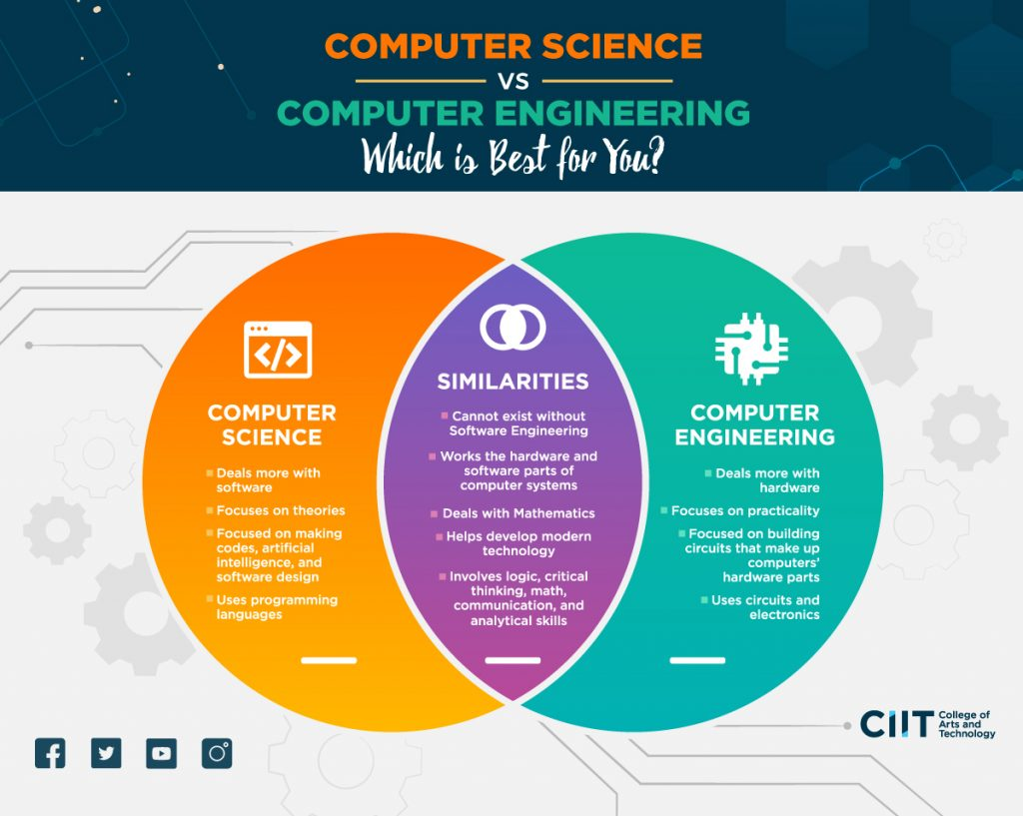

Slide 12

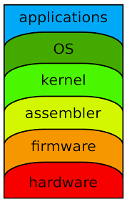

Slide 13
